Slide 1
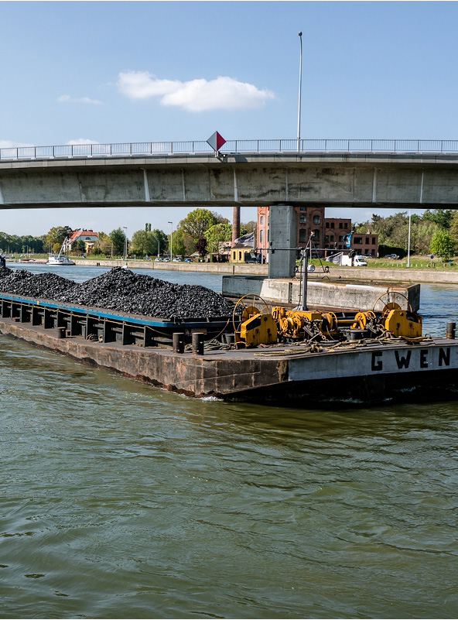
115.113 Economics of Business
International Trade

Slide 2
Specialisation and Trade
02
Comparative Advantage

Slide 3

NZ Wheat Yields
NZ imports most of its wheat from Australia.
Wheat production per hectare in Australia is around 2.8 tonnes.
Why would we import wheat when we are more productive at it?

Slide 4
Specialization
Increased globalization means that most nations engage in both specialization and trade.
Specialization: when an entity produces a narrower range of goods than it consumes, acquiring the rest through trade.
New Zealand specializes in primary products (agriculture, forestry, fisheries).
We depend on rest of world for (most) manufactured goods.

Slide 5
Specialization
Reasons for specialization include:
Comparative advantage in producing particular goods
Economies of agglomeration – cost reductions from locating close to other firms in similar industries
Economies of scale – cost advantages from producing more
Average Dairy herd in NZ is 440 cows.
Average in France is 60-70
There are three main reasons for specialization.
Comparative advantage is an important reason.

Slide 6
Comparative advantage: an example
Consider the case of Carlos and Greta:
Carlos can produce either 4,000 tonnes of wheat or 10,000 apples, or some combination of the two
Greta can produce either 10,000 tonnes of wheat or 12,500 apples, or some combination of the two
Their feasible production frontier is their feasible consumption frontier
Simple example to illustrate gains from trade.

Slide 7
Comparative advantage: an example
Absolute advantage
when someone uses fewer inputs to produce the same good;
or can produce more with the same input)
Greta has absolute advantage in both wheat production and apple production.
Absolute advantage and comparative advantage are not the same thing.
One country can have an absolute advantage in all goods, but not a comparative advantage.

Slide 8
Comparative advantage: an example
Comparative advantage: when someone produces a good at a lower opportunity cost than someone else.
Opportunity cost (output) = loss / gain

Slide 9
Comparative advantage: an example
Comparing the total outputs, the loss (in apples) is 10,000. The gain (in wheat) is 4,000.
10,000/4,000 = 2.5
Carlos’ opportunity cost of 1 tonne wheat = 2.5 apples
Imagine Carlos produces nothing but wheat.
How many apples will be lost?

Slide 10
Comparative advantage: an example
Comparing Greta’s total outputs gives us 12,500 apples (loss) over 10,000 wheat (gain)
12,500/10,000 = 1.25
Greta’s opportunity cost of 1 tonne wheat = 1.25 apples
Greta has the lowest opportunity cost of producing wheat so the comparative advantage

Slide 11
Comparative advantage: an example
Carlos’ opportunity cost of 1 apple = 0.4 tonnes of wheat
(4000/10000)
Greta’s opportunity cost of 1 apple = 0.8 tonnes of wheat
(10000/12500)
Carlos has the lowest opportunity cost hence comparative advantage.

Slide 12
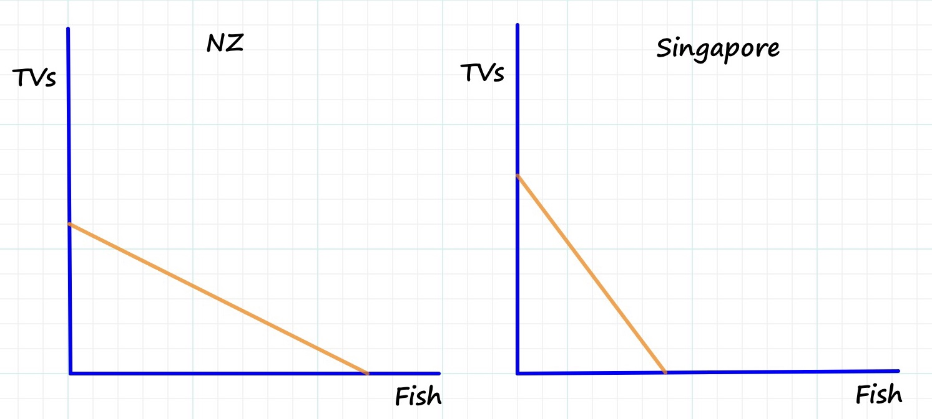
Production Possibility Frontiers
Example 2:
NZ could produce either 30 TVs OR 60 Fish (or any combination in between).
Singapore could produce either 40 TVs OR 30 Fish (or any combination in between).

Slide 13
Output Table
If there was No Trade:
NZ could make 30 TVs or 60 Fish
Singapore could make 40 TVs or 30 Fish
The Opportunity Cost of 1 TV is:
2 Fish for NZ
0.75 Fish for Singapore
The Opportunity Cost of 1 Fish is:
0.5 TVs for NZ
1.33 TVs for Singapore
 | Total Output
 | Total TVs | Total Fish
NZ | 30 | 60
Singapore | 40 | 30
A shortcut to calculating the opportunity cost for any good is the loss/gain rule.

Slide 14
Output Table: Ratios
NZ has lowest opportunity cost of fish
Singapore has lowest opportunity cost of TVs
 | Opportunity Cost of TV
 | Total TVs | Total Fish
NZ | 60/30 | 60
Singapore | 30/40 | 30
 | Opportunity Cost of Fish
 | Total TVs | Total Fish
NZ | 30 | 30/60
Singapore | 40 | 40/30

Slide 15
Under No Trade
Each country’s Production Possibility Frontier is the same as the Consumption Possibility Frontier.
NZ has the lowest input cost for Fish
Singapore has the lowest input cost for TVs.
Production and Consumption
 | TVs | Fish
NZ | 15 | 30
Singapore | 20 | 15
TOTAL | 35 | 45

Slide 16
Under Free Trade
Suppose NZ only produces Fish and Singapore only produces TVs. (lowest opportunity cost)
They then bargain
All trade agreements where any country consumes less than under no trade is rejected.
Any trade agreement where both countries consume more of both goods are feasible.
Because total output is higher with specialisation we can always find a feasible trade agreement.
Production
 | TVs | Fish
NZ | 0 | 60
Singapore | 40 | 0
TOTAL Trade | 40 | 60
Consumption (Example)
NZ | 17.5 | 37.5
Singapore | 22.5 | 22.5

Slide 17
Output Table
What if NZ was better at both goods?
The opportunity cost of 1 TV for NZ is 1.5 Fish
The opportunity cost of 1 Fish for NZ is 0.67 TVs
The opportunity cost of 1 TV for Singapore is 1 Fish
The opportunity cost of 1 Fish for Singapore is 1 TV
There is still a gain from trade if the countries specialise in the good they have the lowest opportunity cost.
Production (No Trade)
 | TVs | Fish
NZ | 20 | 30
Singapore | 15 | 15
TOTAL | 35 | 45

Slide 18
Free Trade
It is always possible to find an allocation that increases total output and provides a gain from trade:
Example:
Singapore completely specialises in TVs and produces no Fish.
NZ keeps 24 workers producing TVs and the rest (96) produce Fish.
They then bargain on a trade agreement.
Production
 | TVs | Fish
NZ | 8 | 48
Singapore | 30 | 0
TOTAL Trade | 38 | 48
Consumption (Example)
NZ | 22 | 32
Singapore | 16 | 16

Slide 19
Back to Greta and Carlos
Let’s consider a trade (price) ratio of 1 tonne of wheat to 2 apples.
01
Carlos specializes in apples
Greta specializes in wheat
Both of their feasible consumption frontiers are above their feasible production frontiers!

Slide 20
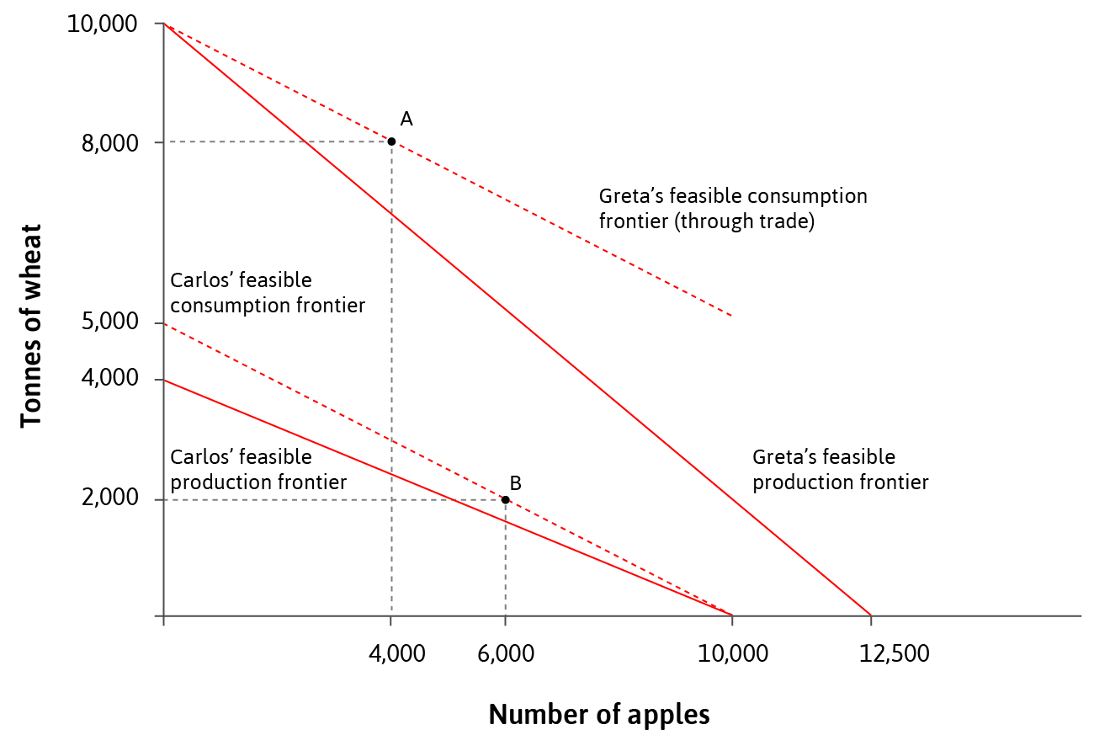
Comparative Advantage: Example
The relative price of apples to wheat depends on each person’s bargaining power and reservation option.

Slide 21
Winners and Losers
Welfare affects of trade

Slide 22
Winners and Losers: Short Run
Opening up to trade increases countries’ consumption possibility sets,
but conflicts of interest emerge between and within countries.
Winners and losers from trade depend on the relative scarcity of factors
e.g. skilled/unskilled labour, capital, etc

Slide 23
Winners and Losers: Short Run
Relatively abundant factors within a country are relatively cheap,
Conversely, the price of relatively scarce factors
and gain when trade raises their price towards the world average.
falls towards the world average due to trade.

Slide 24
NZ Agriculture vs textiles
New Zealand has relatively large amounts of land suitable for many agricultural outputs
New Zealand has relatively small amounts of labour
Opening trade results in gains from agriculture (and those in society that own land)
Opening trade results in losses in textiles (e.g. clothing manufacture) and factors in this sector lose.

Slide 25
Winners and Losers: Short Run
Consider a rich economy abundant in capital that trades with a poor economy abundant in labour:
Workers in the rich economy (and owners of capital in the poor country) will be worse off
Owners of capital in rich country (and workers in the poor country) will be better off.
Overall, the entire economy could grow and offset the losses to the worse off (see the stylized US vs China example in section 18.6)

Slide 26
Winners and Losers: Short Run
Consider a rich economy abundant in skilled labour that trades with a poor economy abundant in unskilled labour:
Unskilled workers in the rich economy (and skilled workers in the poor country) will be worse off
Skilled workers in rich countries (and unskilled workers in the poor country) will be better off.
Overall, the entire economy could grow and offset the losses to the worse off (see the stylized US vs China example in section 18.6)

Slide 27
Hypothetical example
There are 2 goods: passenger aircraft (capital-intensive) and consumer electronics (labour-intensive).
The US is relatively capital abundant, whereas China is relatively labour abundant -> specialization according to factor endowments.

Slide 28
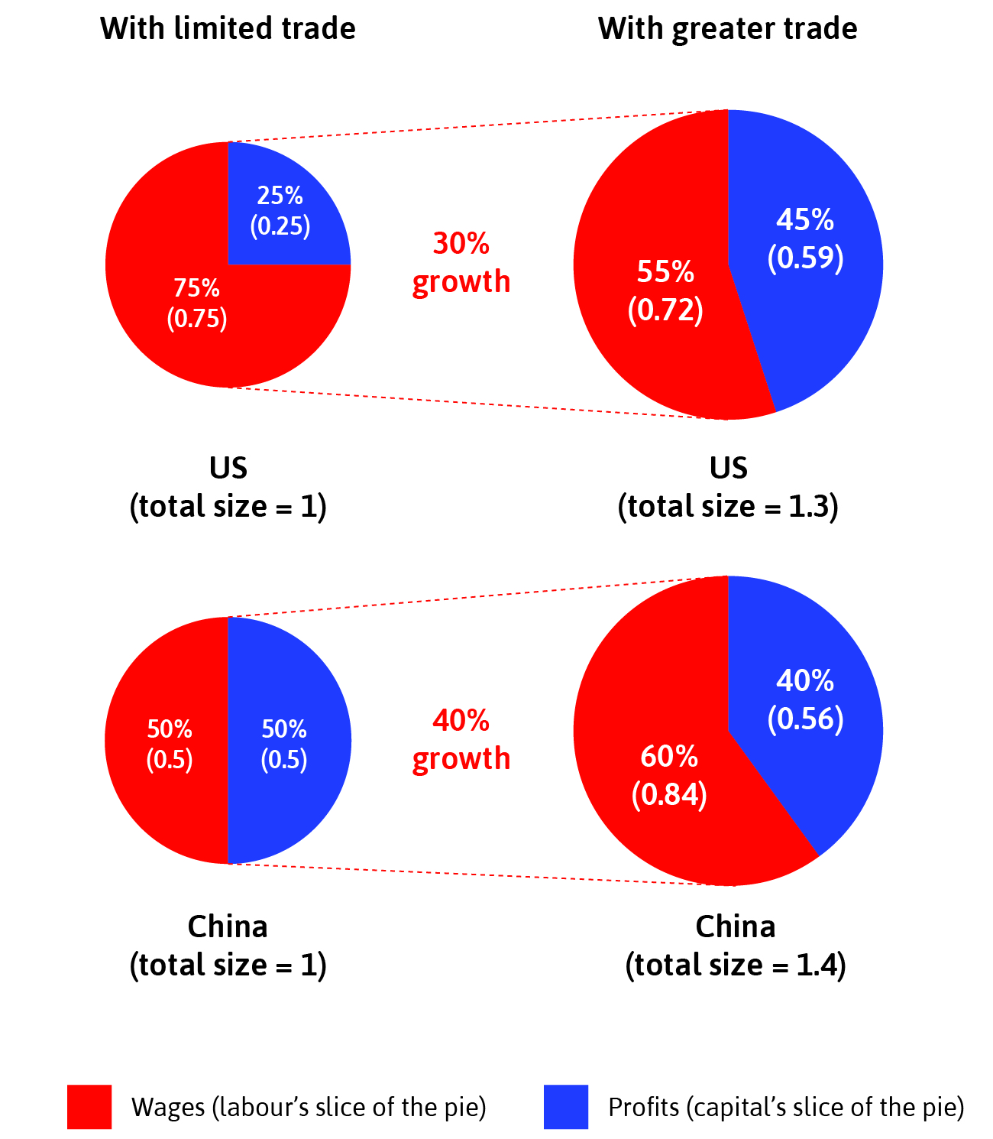
Hypothetical example
Winners in the US: Owners of capital -> inequality should rise
Winners in China: Workers (higher wages) -> inequality should fall

Slide 29
Protectionism
Tariffs

Slide 30
Mercantilism
Critiqued by Hume and Smith.
Hume promoted an early monetary trade theory.
  Inflows of gold cause prices to rise.
  Change in relative prices reduced exports and increased imports.
Smith provided an early theory of absolute advantage.
  By specializing, countries could expand output for their mutual benefit.
Ricardo completes critique with theory of comparative advantage.
Dominant Trade policy in 1600-1700s CE.
Belief that trade was a zero-sum game.
Goal of trade policy was to maximise exports and minimize imports.
Trade surpluses meant you were winning.

Slide 31
Modern Mercantilism
"Trade deficits hurt the economy very badly." (April 26, 2017)
“Trade deficits are no longer merely an economic problem. They are a national emergency that threatens our security and our very way of life.” (April 2, 2025)
“They’ve taken so much of our wealth away from us. We’re not going to let that happen. We truly can be very wealthy. We can be so much wealthier than any country.” (April 2, 2025)
Mercantilism persists in political movements even if rejected by modern economics.
A prominent example is Trump

Slide 32
Tariffs
Tariffs are a common form of trade protectionism.
Quotas used to be common, but have been moved away from.
  NZ used to be a big user of quotas through a licensing system.
Tariffs are often promoted as saving jobs.
But what is the impact of a tariff on an economy?

Slide 33
Discussion
Amiti, Redding and Weinstein (2019)
  "U.S. tariffs were almost entirely passed through into domestic prices, with no evidence of foreign exporters lowering prices to offset the tariffs”
Fajelbaum et.al in 2020
  "We find that the 2018 tariffs led to higher prices for U.S. consumers and resulted in welfare losses.”
US may not perfectly match the motel, but is close enough to still apply.
The model assumes a small country relative to the world?
Does this apply to a large economy like the USA?
Can use the 2018 tariffs to test.

Slide 34
Economy-wide effects
Impact on other producers in an economy.
  US Steel Tariffs reduce employment in steel-using industries. Cost exceeded gains to US steel producers.
  These did not recover after the tariffs were rescinded.
There are few ‘domestic producers’
  Nearly all use parts or components from other countries.
  They benefit less from tariffs.
Market distortions
  Directs activity away from what we are efficient at (comparative advantage) to inefficient industries.
What doesn’t our tariff model capture?

Slide 35
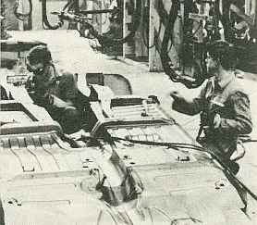
Case Study: NZ Automobile Assembly
Pre-1984
Both CKDs and CBU’s needed import licences
CKD Tariffs were 45%
CBU Tariffs were 55%
Excise taxes were 20%
Sales taxes were 30-33%
23 plants in NZ were assembling CKD’s in 1983/84

Slide 36
Trade Deficits
What causes trade deficits?

Slide 37
Twin Deficit Problem
Take our basic AD equation
  Y = C + I + G + X – M
  X – M is also the Current Account Balance (CAB)
Rearrange to keep the CAB on RHS
  Y – C – I – G = X – M = CAB
Add and subtract Taxes (TX) from both sides. Note where the terms go on LHS.
  Y – TX – C + TX – G = X – M + TX – TX
Y – TX is Household Disposable Income
Many countries have had periods of persistent budget deficits and trade deficits.
Are these related?

Slide 38
Twin Deficit Problem
Household Disposable Income less Consumption (C) is Savings (S)
So we can rewrite equation as
  S – I + TX – G = X – M
S – I is Net Private Savings.
  Household savings less those savings borrowed by firms for investment.
TX – G is Net Public Savings.
Hence term on LHS is Net National Savings.
Many countries have had periods of persistent budget deficits and trade deficits.
Are these related?

Slide 39
Implications
A country that has negative net national savings will run a trade deficit.
  The demand for goods exceeds domestic output so this excess must be spent on imported,
Unless there is a large, offsetting level of positive private savings, a budget deficit will produce a deficit in the Current Account.

Slide 40
US Twin Deficits
Year | Federal Deficit (% of GDP) | Trade Deficit (% of GDP)
2017 | 3.5% | 2.8%
2018 | 3.9% | 3.0%
2019 | 4.6% | 2.9%
2020 | 14.9% | ≈ 2.9%
US Trade Deficits are unlikely to be a result of unfair trade practices.
A major factor appears to be the US Federal Deficit.
Almost all the increase in deficit over CBO projections, was the tax cuts implemented in this period.

